Slide 1
PRODML 1.3 July 2014 DTS Upgrade

Slide 2
DTS Introduction
Temperature measurement spatially distributed over thousands of points
Used in hundreds of facilities for, e.g.:
real-time surveillance,
status of gas lifted or steam wells,
casing /tubing integrity,
leak detection on pipelines
Use is growing and new fiber measurements are emerging

Slide 3
Goals for PRODML DTS Project
Support requirements sufficient for industry-wide adoption.
Data transmission, storage, and interfaces
Fiber Asset Management
Metadata
Provide PRODML Schema & guidelines so vendor software can be interchangeable, allowing mix-and-match hardware and software
Create compelling standard that attracts OCs and vendors
...promoting products that plug into multiple vendors hardware for data acquisition and integrate out of the box with consumer products on the front-end.

Slide 4
DTS Challenges
Data is traces (like logs) not point values
~ 1MB per trace per ~ minute per well
Configuration and condition of fiber needs to be known and managed
Complex configurations becoming common
Condition, faults etc. change over time
No standard interface for whole data transfer (earlier PRODML partial coverage and not fully standardised)

Slide 5
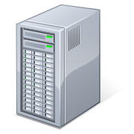
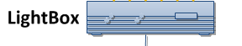
Typical DTS System and challenges
Field
Office Domain
DTS Repository
Inventory Mgmt.
PRODML V1 or other
reliability problems
Not related hence data not mapped to assets
Proprietary
Proprietary and largely manual
Instrument
Box
Surveillance &
Analysis Tools
Historian &
Completion Data
DTS
Fiber
DTS
Fiber
Wells
Pipelines
Heaters
Leak Detection…
Config changes over time
Product Scope
Notes:
Transport App: It’s the UPS for ASP.
Robust and Reliable mechanism for sending data over to the office domain.
Future Proof: Supports any type of advanced sensing data, not only DTS. (File based).
Based on Shell Global Standards: No need for step-outs.
Based on Industry Standards: Vendors can easily make use of the transport mechanism or its infrastructure (i.e. Schlumberger)
Traffic Light Web App: It’s the CNN for ASP
Provide complete transparency on the status of the ASP world. Have confidence that ASP data is being generated and managed properly.
Quality tagging of all data received. Early detection of problems down the line. Have confidence that ASP data is good and will be useful.
Get notified when something goes wrong. Don’t find out when it’s too late.
Preview/Selection Site: It’s the Music Store for ASP
Browse all the ASP related files that have been received in the office domain. No more digging around endless folders in network shares.
Preview their contents before you download.
Compare ASP data against PI readings to help you select the date range of your interest. No more manual filtering based on guesses.
Compare ASP data against Well Completion data. Quickly determine the level of calibration that may be needed before attempting any time-consuming work.

Slide 6
PRODML DTS Enhancements
Provide Standard interface for acquiring data from Instrument box of multiple vendors
Provide standard transport to move data across varying infrastructures and security zones.
Provide storage that retains current and historical information on fiber assets, and measurements/quality, calibration, and actions taken on/from these assets.
Provide a standard interface to allow visualization, analytics, and other consumers to access out of the box.

Slide 7
Typical DTS System Exploiting PRODML
Field
Office Domain
Transport App
DTS Repository
PRODML
Inventory Mgmt.
Portal
PRODML
PRODML-enabled transport app resolves reliability problems
View and Manage DTS related Assets
PRODML
PRODML
Instrument
Box
Surveillance &
Analysis Tools
Historian &
Completion Data
PRODML
DTS
Fiber
DTS
Fiber
Config changes over time
Wells
Pipelines
Heaters
Leak Detection…
Product Scope
Notes:
Transport App: It’s the UPS for ASP.
Robust and Reliable mechanism for sending data over to the office domain.
Future Proof: Supports any type of advanced sensing data, not only DTS. (File based).
Based on Shell Global Standards: No need for step-outs.
Based on Industry Standards: Vendors can easily make use of the transport mechanism or its infrastructure (i.e. Schlumberger)
Traffic Light Web App: It’s the CNN for ASP
Provide complete transparency on the status of the ASP world. Have confidence that ASP data is being generated and managed properly.
Quality tagging of all data received. Early detection of problems down the line. Have confidence that ASP data is good and will be useful.
Get notified when something goes wrong. Don’t find out when it’s too late.
Preview/Selection Site: It’s the Music Store for ASP
Browse all the ASP related files that have been received in the office domain. No more digging around endless folders in network shares.
Preview their contents before you download.
Compare ASP data against PI readings to help you select the date range of your interest. No more manual filtering based on guesses.
Compare ASP data against Well Completion data. Quickly determine the level of calibration that may be needed before attempting any time-consuming work.

Slide 8
Use Cases and Key Concepts

Slide 9
Principle Use Cases
Configuration of & changes in fiber assets
Optical path comprising: fiber segments, connectors, splices, conveyance, anomalies…
Instrument box + path combinations: generate data
Calibrations and condition monitoring
For an installed DTS system, transfer trace data from field to office
Transfer temperature data mapped from trace to actual facilities (wells, pipes etc.)

Slide 10
Top Level Data Objects
Optical Path
(series of fiber segments & components)
Instrument Box
(surface “Light Box” instrument)
Pairing in time of
Installed System
(path + box which makes measurements)
Generates
Measurement Set
(Measured Trace of raw data plus Log of temperature mapped to facilities)

Slide 11
Optical Path
Describes all components through which light passes (fiber + other components)
Can span more than one wellbore
Provides mapping from path length to position in a facility (wellbore or pipeline)
Records defects that impact measurements
Conveyance
Shows changes versus time

Slide 12
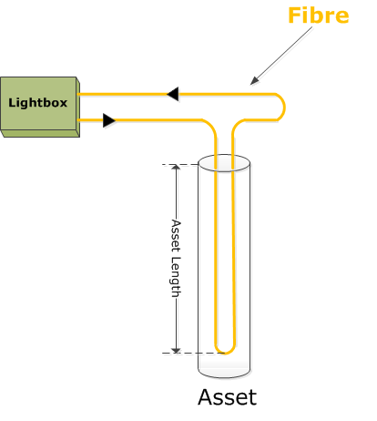
Optical Path Components
Fiber Segment (one continuous piece of fiber)
Instrument
Box
Splice
Terminator
Connectors
U
Turnaround

Slide 13
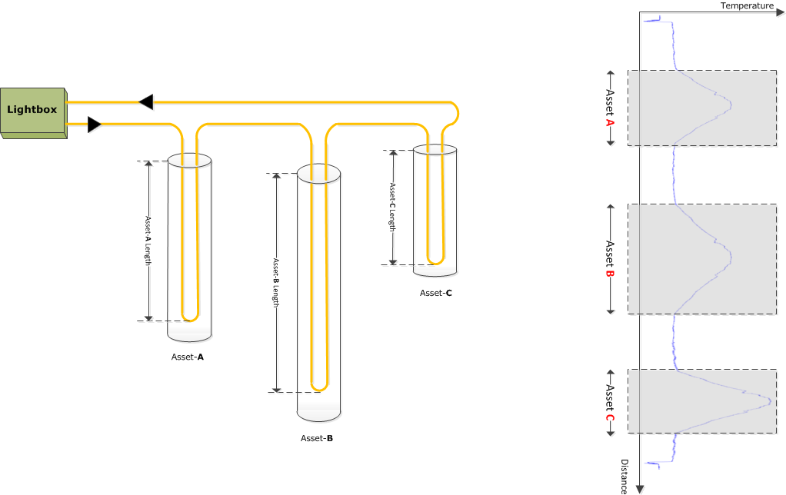
Optical Path Can Span Multiple Facilities
Facility Length
Instrument
Box
Pipeline 1
Facility Length
Facility can be wellbore or pipeline
Facility Length
Well A
Well B

Slide 14
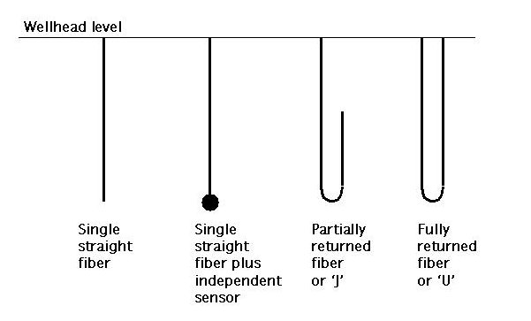
Fiber may be linear or “folded” along the facility (well, pipeline etc.) being measured
“Overstuffed” fiber longer than facility

Slide 15
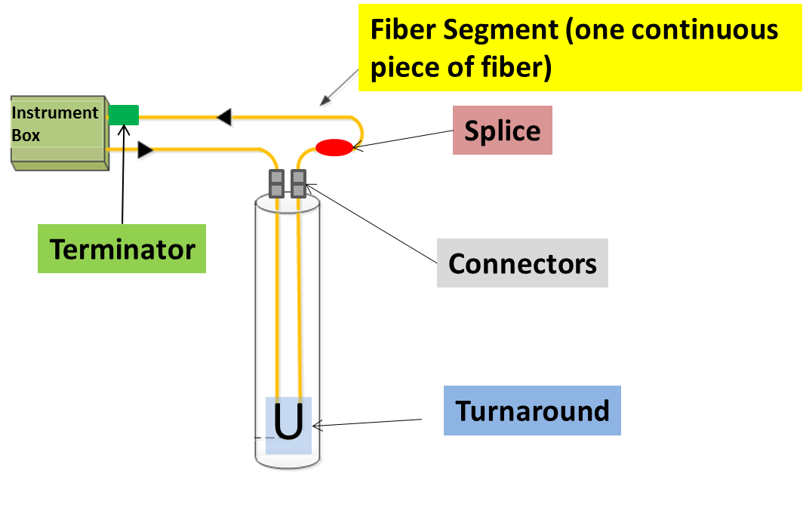
Optical Path Connectivity Representation
PRODML Network Representation
Network (represents the whole optical path)
Unit (represents each component)
Port (place where component connects)
Node (virtual point of connection)
Section illustrated
Ins. Box port
fiber segment 1
connector 1
fiber segment 2
Node a
Node b
Node…
Port 1
Port 2
Port 1
Port 2
Port 1
Port 2
First component (and terminator*) can name Instrument Box port connected
Each component is a “unit”
Each unit has 2 ports
Ports with a common “connected Node” are connected
etc
* - for double ended systems looped back to box

Slide 16
Fiber Facility Mapping links path distance to facility length, enabling facility “logs” to be made
Facility Length
Instrument
Box
Well A
Pipeline 1
Facility Length
Per Mapping:
Path distance start
Path distance end
Facility length start
Facility Length end
fold
Well B
Facility Length
Well A
Pipeline 1
Well B

Slide 17
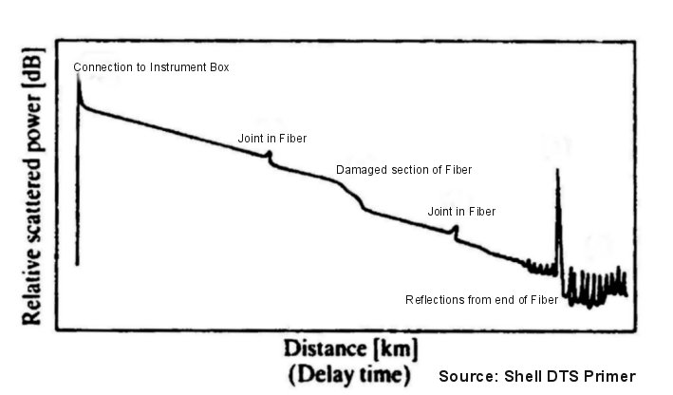
Fiber Defects recorded along Optical Path (Example data from OTDR test)
Defects are recorded with respect to distance along path, time over which effective, and type

Slide 18
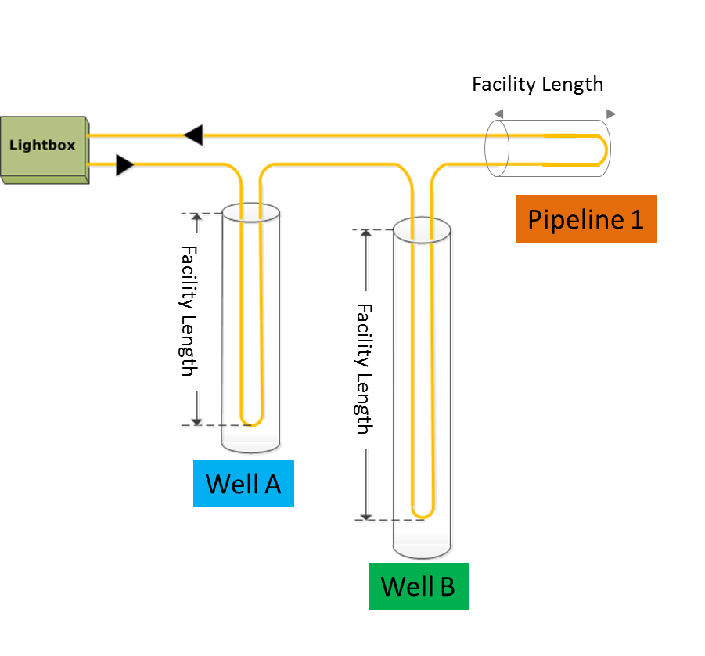
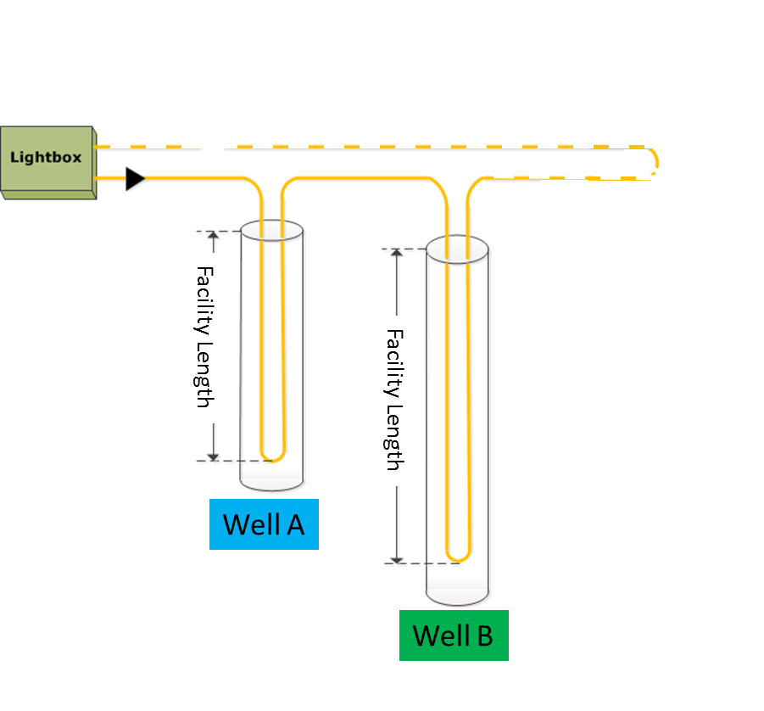
Optical Path may record changes over time: use of Inventory and Network allows for this
This would be a new Network of installed components
These decommissioned segments can stay in Inventory for reliability trend analysis, etc
Instrument
Box
Instrument
Box

Slide 19
Conveyance – how a fiber is physically installed in a facility
Permanent Conveyance
Fiber in cables (various kinds)
Fiber inside a control line
Control line details
Pumping details for fiber pumped into control line
Intervention Conveyance
Records fiber conveyed on wireline, coiled tubing etc.
In future these could be linked to Completion “Equipment” for permanent installations, and “Job” for interventions

Slide 20
Instrument Box has properties and records calibration
Properties including reference temperatures, warm up time etc
Manufacturer details
Factory calibration details

Slide 21
Installed System is a combination of Instrument Box + Optical Path
Permanent Type
“Single Channel Instrument Box”
One fiber, one box, one facility
= 1 Installed System
“Multiplexed Instrument Box”
One box with multiplex, two facility, two fiber,
= 2 Installed System
Instrument
Box
Instrument
Box
Well A
Well B

Slide 22
Installed System cont.
Temporary Type
“Drive-by” DTS
One box taken to different facility/pre-installed fiber and hooked up for single survey
= 1 Installed System for each “drive-by hook up”
“Logging Operation”
One temporary fiber, one box, one facility
= 1 Installed System for each “logging operation”
Instrument
Box
Instrument
Box
Instrument
Box
Instrument
Box
Well A
Well B
Well C

Slide 23
DTS Measurement is the output from an operational DTS & is divided into two parts
The measured trace set which:
Is indexed against fiber distance
Can contain a controlled list of curves corresponding to “raw” data and temperature
The interpretation log set which:
Is indexed against facility length for a specific facility (e.g. like a well log)
Can contain only the processed temperature result

Slide 24
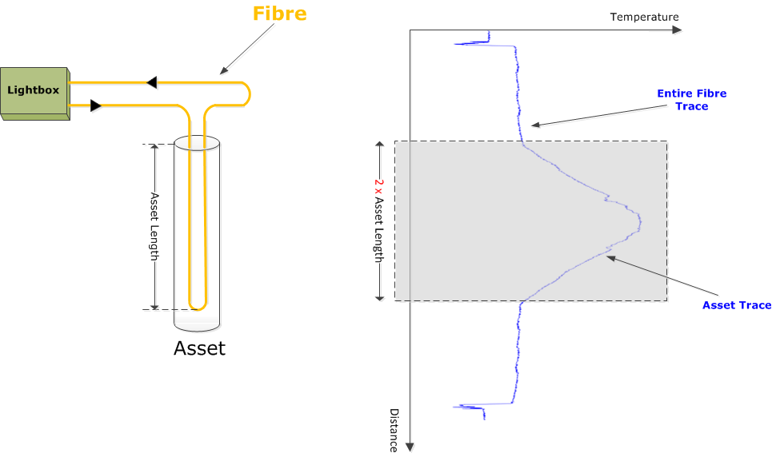
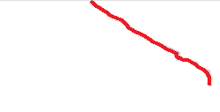
DTS Measurement Concept: 1 – record measured trace; 2 – record interpreted log
1
Measured Trace Set
Interpretation Log
2
Instrument
Box
Whole Traces
Raw measurements
Facility Length
2 X Facility Length
Folded Part of Trace for Facility
Index: Facility Length
Facility
Index: Optical Path Distance

Slide 25
DTS Measurement – contains:
Only one set of traces/logs for a single DTS acquisition (over a time range)
Can contain “child” logs/traces which have been processed from parent logs, e.g. by averaging (parents may be in multiple other logs), recalibrated (from a parent) etc
Measurement Tags to ID events, e.g. well start up; Diagnostic Parameters

Slide 26
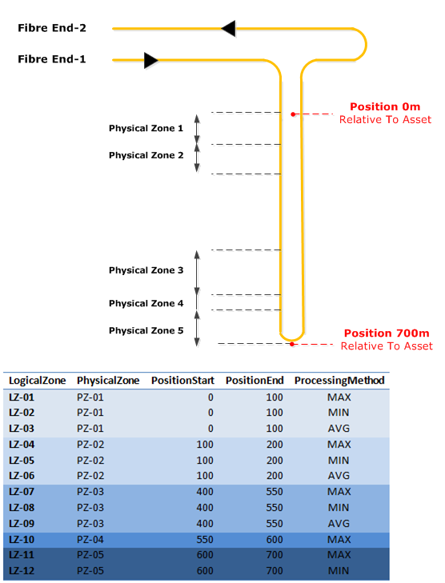
Facility Mapping could be used to define “zones”, e.g. contact intervals, to be reported using “mini-logs”

Slide 27
Summary
Major step in DTS reporting upgrades original standard for up to date practices
Multiple facilities on one path
Logging and other conveyance
Controlled lists of curves eliminates previous log curve ID ambiguity
Keeps measured and interpreted data together
Supports equipment tracking over time

Slide 28
Potential Future Growth
Other “DxS” sensing, e.g. acoustics (DAS)
Closer integration with Completion object, e.g. for DTS as physical strings located in wellbore equipment, operations as “Jobs”

Slide 29
Appendix - Technical

Slide 30
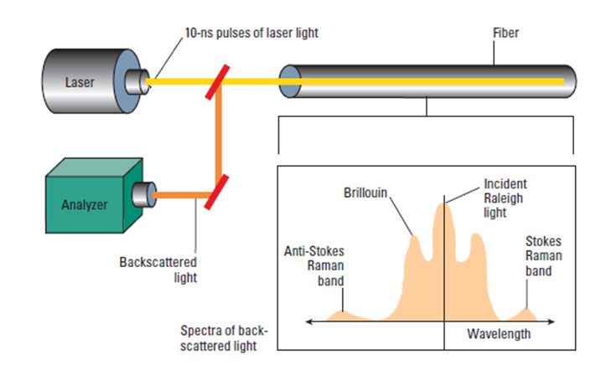
Principle of DTS: Laser light down optical fiber

Slide 31
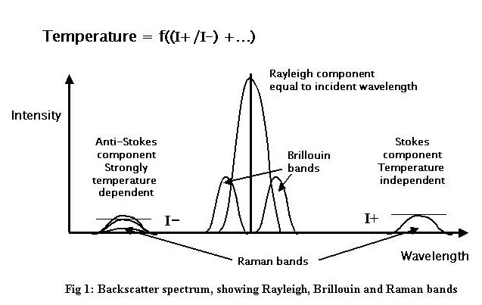
DTS uses back-scattered light to measure temperature all along the fiber

Slide 32
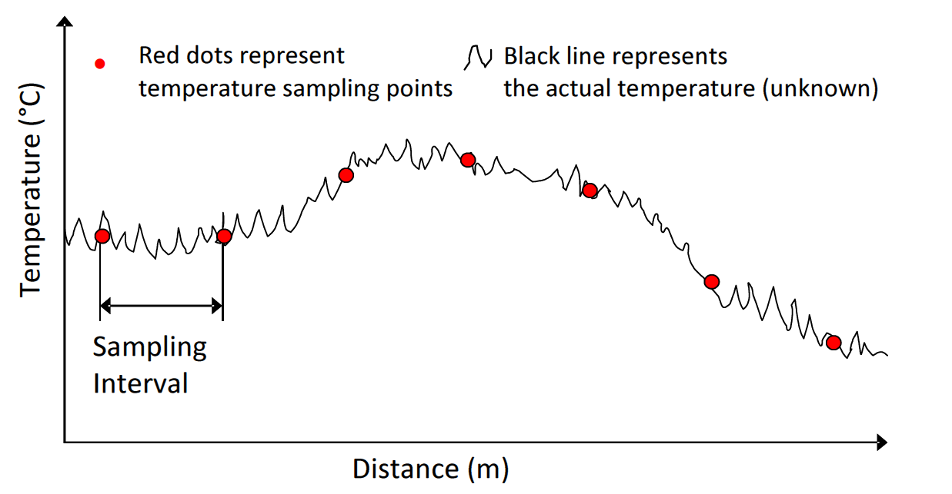
Temperature sampled at regular intervals creating a trace indexed along the fiber

